Slide 1
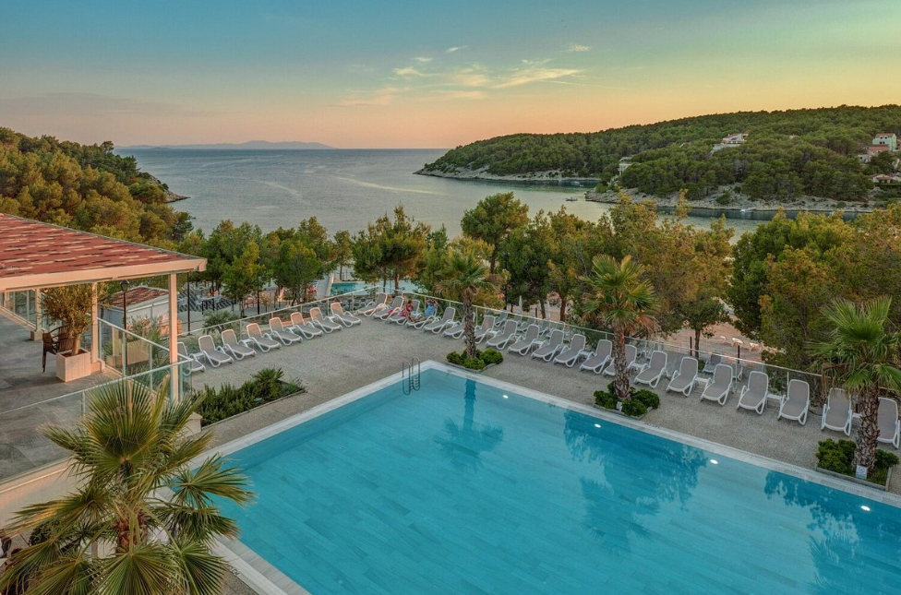
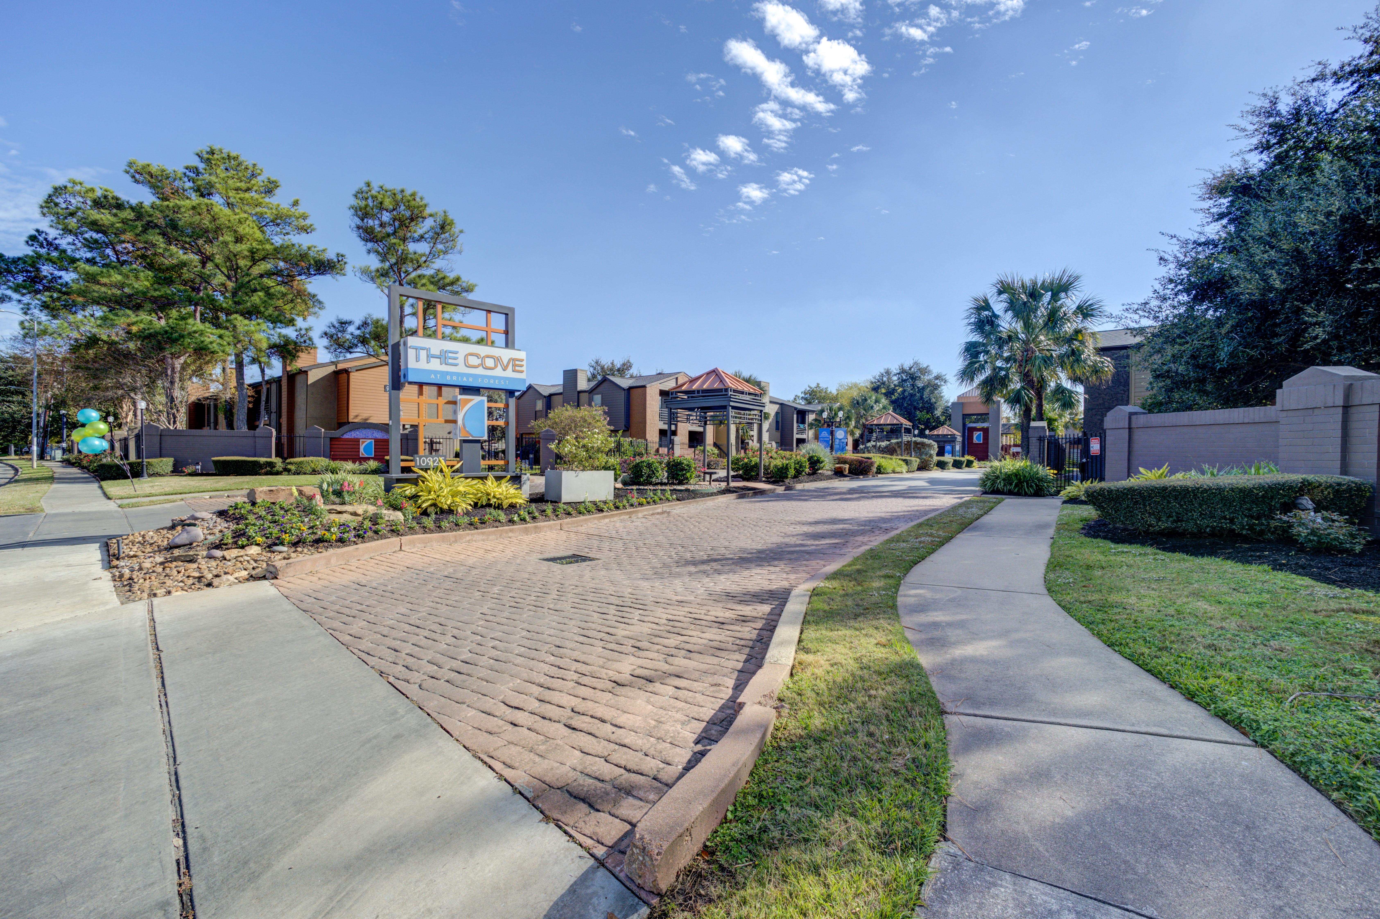
XX Resort & Cotteges
dan bisdava I. 118 A, Nailna, Srac Island 21405 Russia

Slide 2
Disclaimer
This Conﬁdential Information Summary (the “Summary”) contains proprietary non-public information regarding Project XXResort (the “Property”) and has been created on a conﬁdential basis. The information contained herein has been obtained from the Owner, Manager, Property Manager, the General Partner and Investors (Owner and Shareholder and other sources) of the company (“Company”), its shareholders, and other sources, and has been prepared for the purpose of providing interested parties with general information to assist them in their evaluation of the investment. No representation or warranty, expressed or implied, is made by YYY(“WXYZ”), including it associates, affiliates, partners, and staff, as to the accuracy or completeness of such information or any other written or oral communication transmitted or made available to a prospective investor or any part thereof. Nothing contained in the Memorandum is, or shall be relied upon as, a promise or representation, whether as to the past or the future performance of the investment. Any estimates or projections contained herein have been prepared by, and are based on information currently available to WXYZ, and involve signiﬁcant subjective judgments and analyses and, accordingly, no representation is made as to their attainability. Only those representations and warranties made in a deﬁnitive, written agreement, and subject to such limitations and restrictions as may be speciﬁed therein, shall have any legal or binding effect.
This material is for informational purposes only and is not intended to be used as the basis of an investment decision or as legal, accounting or tax advice. This material is not an offer or the solicitation of an offer to sell or buy any security.
Recipients of this Memorandum are bound by a previously executed non disclosure and conﬁdentiality agreement and agree that all of the information contained herein is of a conﬁdential nature, that they will treat it in a conﬁdential manner consistent with the terms and conditions of the agreement, that they will not, directly or indirectly, disclose or permit their agents, representatives, employees, officers, directors or affiliates to disclose any of such information and that they will use the Memorandum and any related information only to evaluate an investment transaction and for no other purpose. If either the recipient or WXYZ elects not to pursue this matter, the recipient will return this Memorandum and any other material relating to the investment, which the recipient may have received from WXYZ without retaining any copies thereof. WXYZ and the company reserves the right to negotiate with one or more prospective investors at any time and to enter into a deﬁnitive agreement for the investment without prior notice to the recipient or other prospective investors. Also, WXYZ and the company reserves the right not except an investment and to terminate, at any time, further participation in the investigation and proposal process by any party and to modify data, documentation, conﬁdentiality and other procedures at any time without assigning any reason therefore. WXYZ has been engaged by the client/company as its global consultant for this transaction. WXYZ has not been retained to verify the information contained herein. Each recipient hereof is responsible for conducting its own independent analysis of any proposed transaction and for independently verifying the information contained herein. Each recipient agrees not to contact any owners, officers, directors, employees, representatives, agents or affiliates of the client/company and make all further inquiries directly to WXYZ. This Memorandum is not, and under no circumstances is to be construed as, a prospectus, a public offering or an offering memorandum as deﬁned under securities legislation applicable to the Property. All ﬁnancial ﬁgures included in the Memorandum are in US Dollars unless noted otherwise.
All communications, inquiries and requests for information relating to the Memorandum or to a possible transaction involving the investment should be addressed to:
Dffd
Dfdfd
dfdfdfdfdf
© 2022 Globalvestment| CONFIDENTIAL | Page 2

Slide 3
TABLE OF CONTENTS
04 EXECUTIVE SUMMARY
07
08
12
23
37
52
WHY INVEST
HOUSTON
DEMOGRAPHICS
LOCATION/PICTURES
FINANCIAL SUMMARY
CONTACT US
© 2022 Globalvestment| CONFIDENTIAL | Page 3

Slide 4
croatia
Croatia is a country located in Southeast Europe on the eastern coast of the Adriatic Sea. It shares borders with Slovenia to the northwest, Hungary to the north, Serbia to the northeast, Bosnia and Herzegovina to the east, and Montenegro to the southeast. To the southwest, it has a coastline along the Adriatic Sea.
Capital | The capital city of Croatia is Zagreb, which is also the largest city in the country.
Population | As of 2023, the total population of Croatia was 4.05 million
Geography | Croatia is known for its diverse geography, which includes plains, lakes, rivers, mountains, and a long coastline along the Adriatic Sea. The country is renowned for its stunning coastline with numerous islands, making it a popular destination for tourists.
Economy | Croatia has a mixed economy, with various industries including tourism, agriculture, shipbuilding, and manufacturing. Tourism is a significant contributor to the country's economy.
Culture & Tourism | Croatia is known for its rich cultural heritage, which is reflected in its architecture, festivals, and traditions. It's also a popular tourist destination, attracting millions of visitors each year.
Notable Landmark | Croatia is home to many notable landmarks, including the ancient city of Dubrovnik , Diocletian's Palace in Split, Plitvice Lakes National Park, and the historic city of Zagreb.
CROATIA
BRAC
PROPERTY
General Info
Map
Key USP
Economy
Local Attraction
Beyond Tourism
Demography
Market Overview

Slide 5
Location
Croatia, which located in southeast Europe, has a varied geography. Low mountains and highlands close to the Adriatic coast, flat plains that follow the Hungarian border, and a large number of islands are all aspects of the crescent-shaped nation.
Mountainous areas experience cold, snowy winters and pleasant summers. The coastal regions of the nation experience a Mediterranean climate, which features warm, sunny summers and mild winters. Off this coast, there are more than a thousand islands. Many, notably the Dalmatian coast, are popular tourist destinations.
Over 1200 islands are located off the coast of Croatia, which has a 1778 km long coastline. But only a small number of them are populated. Krk, Cres, and Bra are the names of the three largest islands in Croatia. Croatia is split into three principal geographic regions: The Adriatic coast with its numerous tiny and large islands is on the one hand. It can be separated into the Istria, Kvarner Bay, and Dalmatia regions, running from north to south.
The Dinaric Mountains connect the Adriatic coast to the east. A lowland that is a part of the Pannonian lowlands is located in the north and northeast.
CROATIA
BRAC
PROPERTY
General Info
Map
Key USP
Economy
Local Attraction
Beyond Tourism
Demography
Market Overview

Slide 6
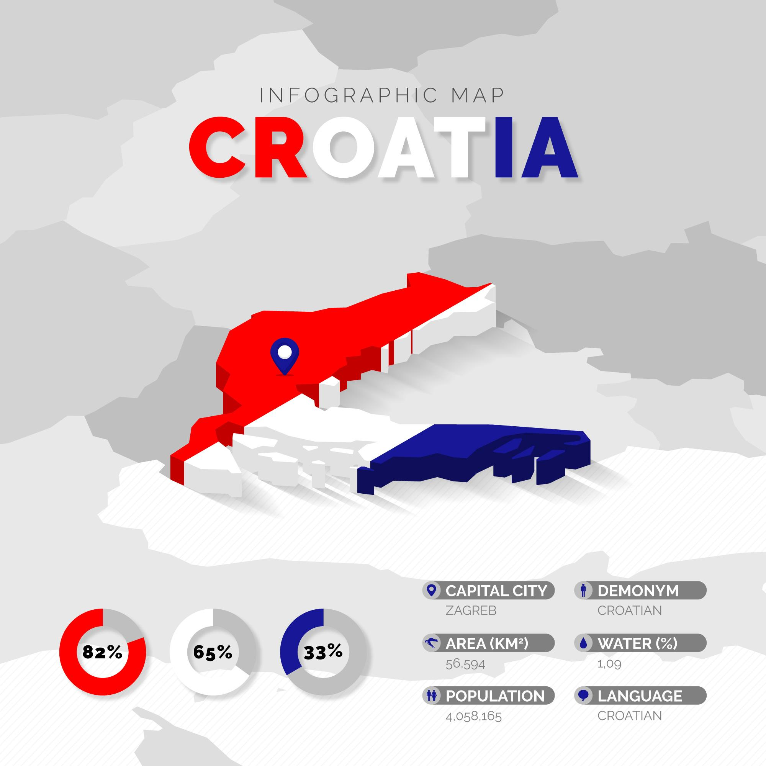
CROATIA
BRAC
PROPERTY
General Info
Map
Key USP
Economy
Local Attraction
Beyond Tourism
Demography
Market Overview

Slide 7

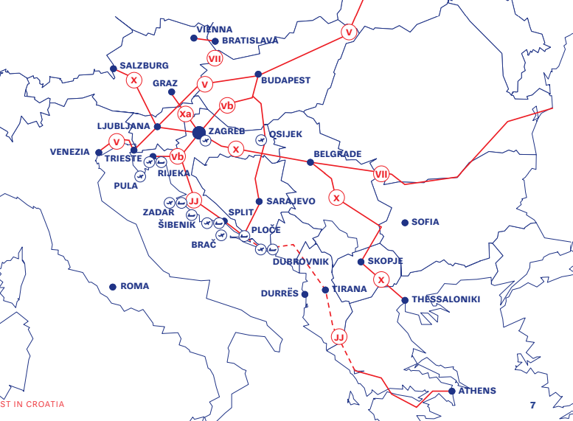
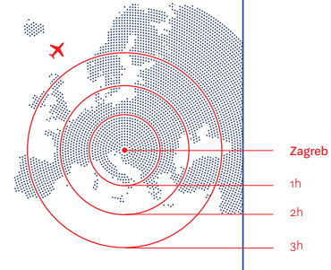

Key USP of Croatia
Strategic Location – Croatia shares border with 3 CEFTA countries (Serbia, Montenegaro, Bosnia and Harzegovina). It is also a member of Euro and the Schengen Areas.
Infrastructure – With 9 international airports, all of Europe is within 3 hours range. It has secured 13th place out of 141 on the Quality of Road Infrastructure (WEF Global Competitiveness Report 2019). Further, there is a direct access to Rhine – Main Danube waterway through four main riverports.
CROATIA
BRAC
PROPERTY
General Info
Map
Key USP
Economy
Local Attraction
Beyond Tourism
Demography
Market Overview

Slide 8


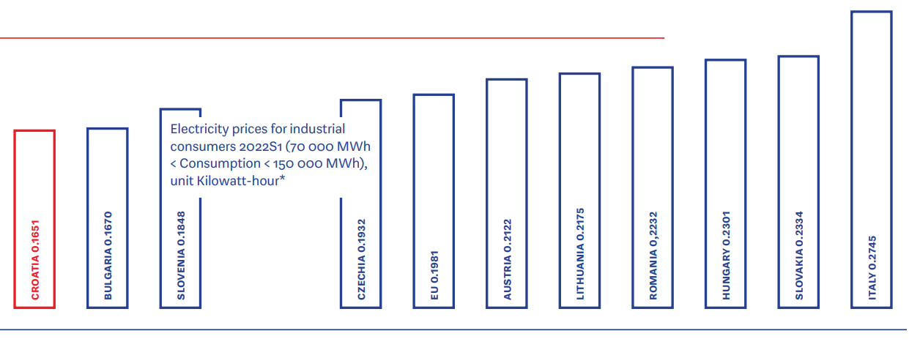

Key USP of Croatia
Foreign Direct Investments – 42.55 billion euros worth of foreign direct investments have been made in Croatia between 1993 and 2022.
Cost of Doing Business - In comparison to the average cost of doing business in the EU, Croatia has significantly lower costs. The cost of gas and electricity in the area is among the lowest. Contributions (social taxes) from and on salaries are paid at a rate of 36.5%, with the employee and employer each contributing 20% and 16.5%, respectively.
Incentive for Investments - A non-repayable grant of up to EUR 500,000 must be approved for the purchase of plant or machinery to be used for investment in development and innovation activities. However, the plant or machinery must be high-tech equipment and account for 20% of the actual eligible costs for purchase.
CROATIA
BRAC
PROPERTY
General Info
Map
Key USP
Economy
Local Attraction
Beyond Tourism
Demography
Market Overview

Slide 9
Economy – Past & Present
Strong private consumption, better-than-expected results in the tourism sector, and a surge in exports of goods all helped Croatia recover from the pandemic. Croatian exports grew quickly in 2021 and 2022, by approximately 25% and 26%, respectively. In 2021, exports totaled 143.7 billion Kuna, and in 2022, they increased by another 26% to a predicted 182 billion Kuna.
The Croatian economy is highly receptive to foreign trade. Almost two thirds of trade is done with other members of the European Union (EU), however trade with Croatia's neighbors in southeast Europe also accounts for a sizeable portion. Croatia's biggest export markets are Italy, Bosnia and Herzegovina, Germany, Slovenia, and Austria, while its top import markets are Germany, Russia, China, and Slovenia.
In order to further integrate with its European partners and accomplish its main strategic goals, Croatia joined the Schengen area in January 2023 and became the 20th EU Member State to do so.
Due to its extensive Adriatic coastline, Croatia enjoys easy access to major maritime lanes. Through the Suez Canal, the important seaports of Rijeka, Sibenik, Split, Ploe, and Dubrovnik connect Asia and Australia with Europe.
CROATIA
BRAC
PROPERTY
General Info
Map
Key USP
Economy
Local Attraction
Beyond Tourism
Demography
Market Overview

Slide 10
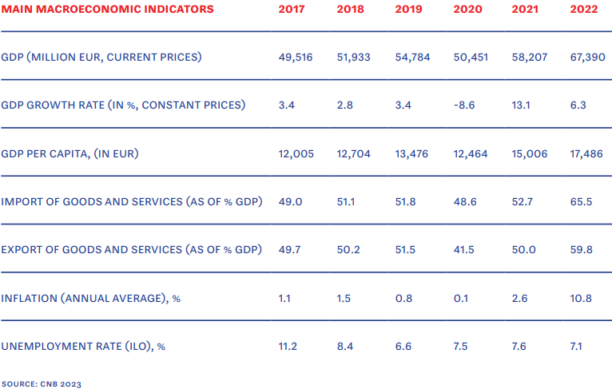
Economy – Past & Present
Croatia's economy is a high-income, service-based social market economy, and the tertiary sector contributes 70% of the country's total gross domestic product (GDP).
The economy of Croatia is fully interconnected and open to the world.
Croatia began its journey toward globalization as soon as it attained independence, with one of its main industries—tourism—being reliant on the international market.
CROATIA
BRAC
PROPERTY
General Info
Map
Key USP
Economy
Local Attraction
Beyond Tourism
Demography
Market Overview

Slide 11
Economy - Future
Fiscal and Monetary Conditions to remain supportive
Improved activity and supportive prices in 2022-23 have buoyed government revenue while public spending was short of targets. This led to a minor surplus in the budget leading to a reduction in the public debt ratio. In March 2023, Govt announced its fourth energy response package. The EUR 1.7 billion package (equivalent to 2.3% of GDP in 2023) extends price subsidies while supporting renewable and energy-efficient investments. These measures will apply till April 2024 and help gradually strengthen Croatia as it integrates into the Euro area.
Improved Investments, higher incomes and curtailed inflation will help lift growth
Household consumption is anticipated to increase, supporting overall GDP growth, as real income recovers as a result of rising salaries and ongoing employment growth. Inflation should continue to decline as a result of falling energy costs and supply disruptions on a global scale. Investment is anticipated to increase demand, supported by increased governmental spending, foreign investments, and exports.
Increasing access to education can increase opportunities.
More countercyclical fiscal policy will strengthen competitiveness and ease capacity limitations as household consumption improves and integration into the Euro and Schengen region boosts demand. The Croatian economy can develop the skills necessary for sustained and long-term growth by increasing the availability of high-quality adult and vocational education programs and enhancing their accessibility.
CROATIA
BRAC
PROPERTY
General Info
Map
Key USP
Economy
Local Attraction
Beyond Tourism
Demography
Market Overview

Slide 12
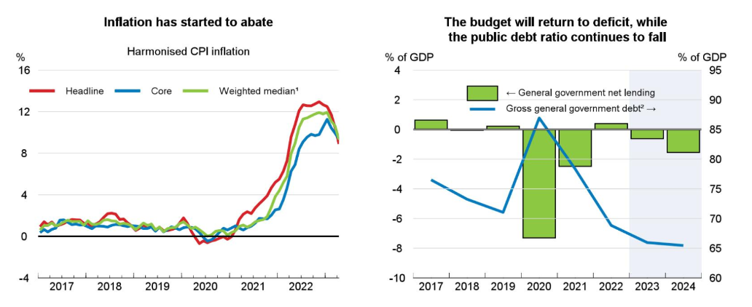
Economy - Future
Croatia is in a good position to leapfrog on multiple fronts during the next decade.
The public debt is steadily declining, the labor market is improving, and Croatia has made progress in crucial areas like the business climate and institutional quality. The country's economy is currently increasing at a rate of roughly 3% yearly. This has produced a setting where the benefits of additional changes could be significant, resulting in faster economic convergence with the EU and better economic growth. However, economic expansion can only continue if it results in widespread prosperity. Furthermore, while economic growth is a necessary condition for raising welfare, it is insufficient in and of itself to improve quality of life.
CROATIA
BRAC
PROPERTY
General Info
Map
Key USP
Economy
Local Attraction
Beyond Tourism
Demography
Market Overview

Slide 13
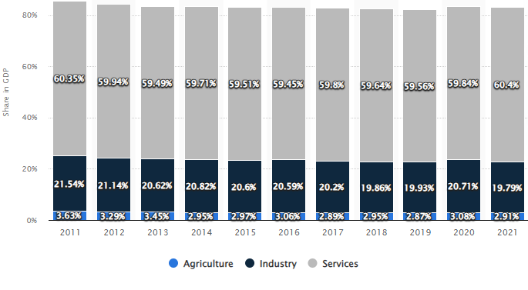
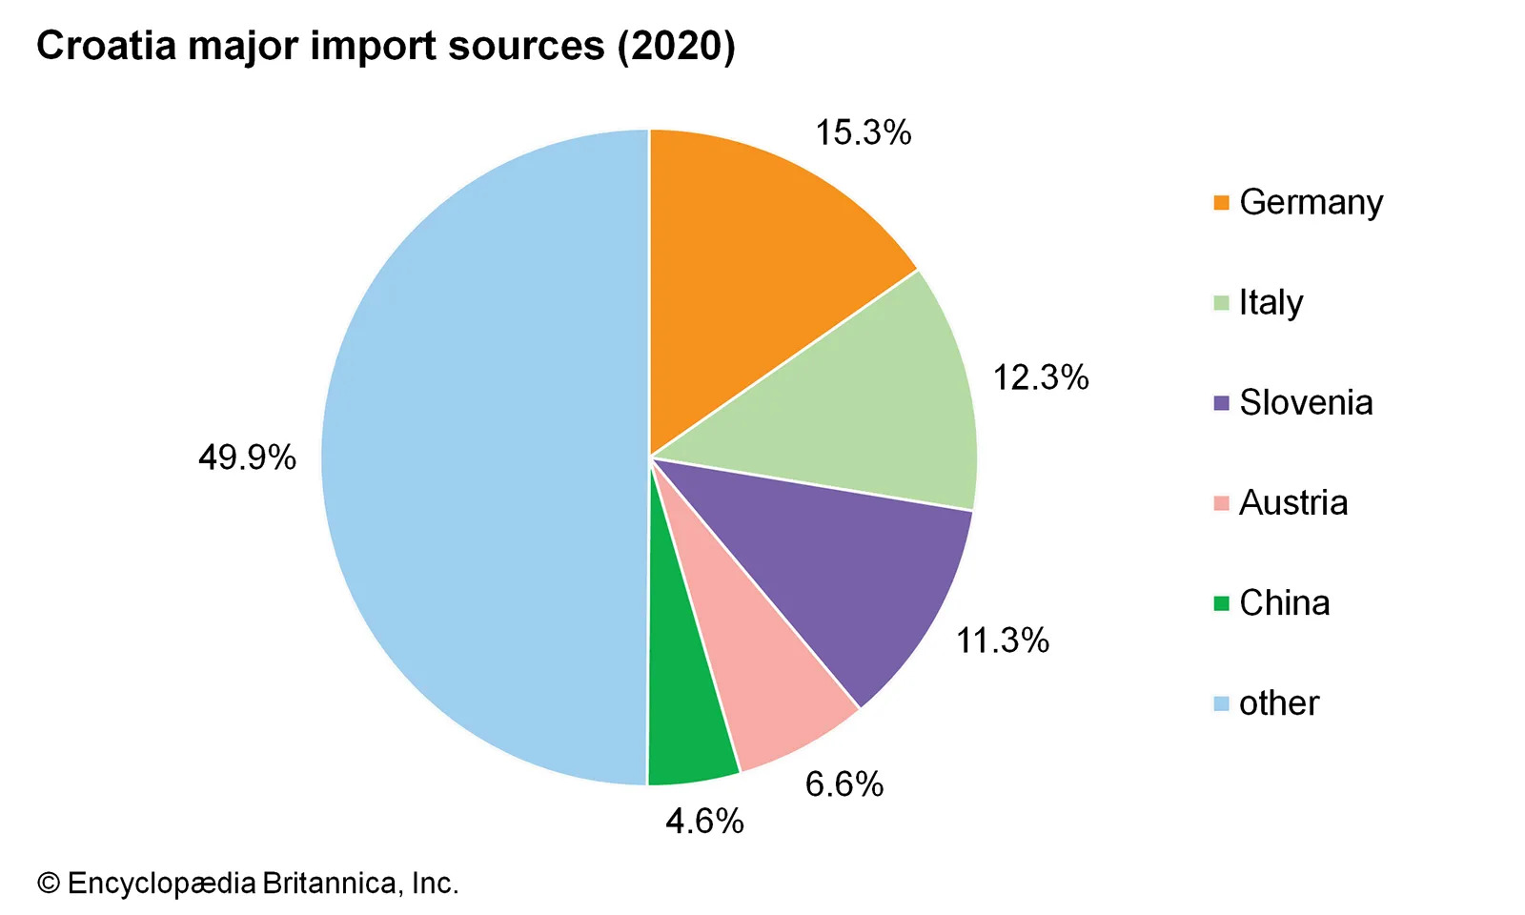
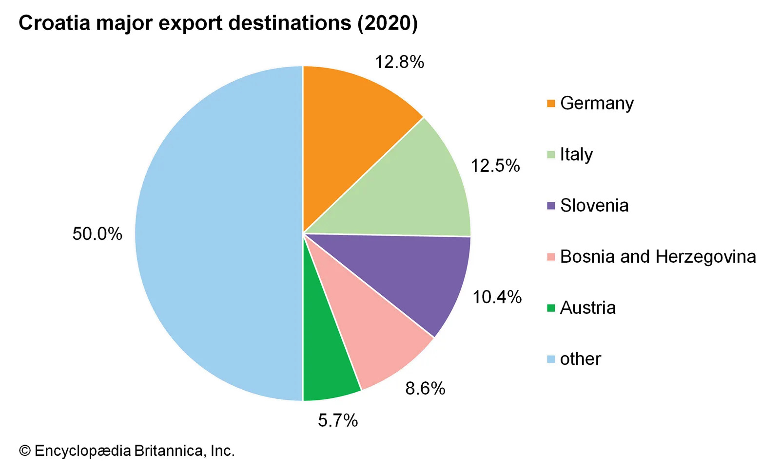
Economic Structure
Share of Economic Sectors in Croatia’s GDP - Services holds most of the GDP Share %
Croatia’s Trade: Sources & Destinations - Varied Routes Create a Thriving Economy
CROATIA
BRAC
PROPERTY
General Info
Map
Key USP
Economy
Local Attraction
Beyond Tourism
Demography
Market Overview

Slide 14
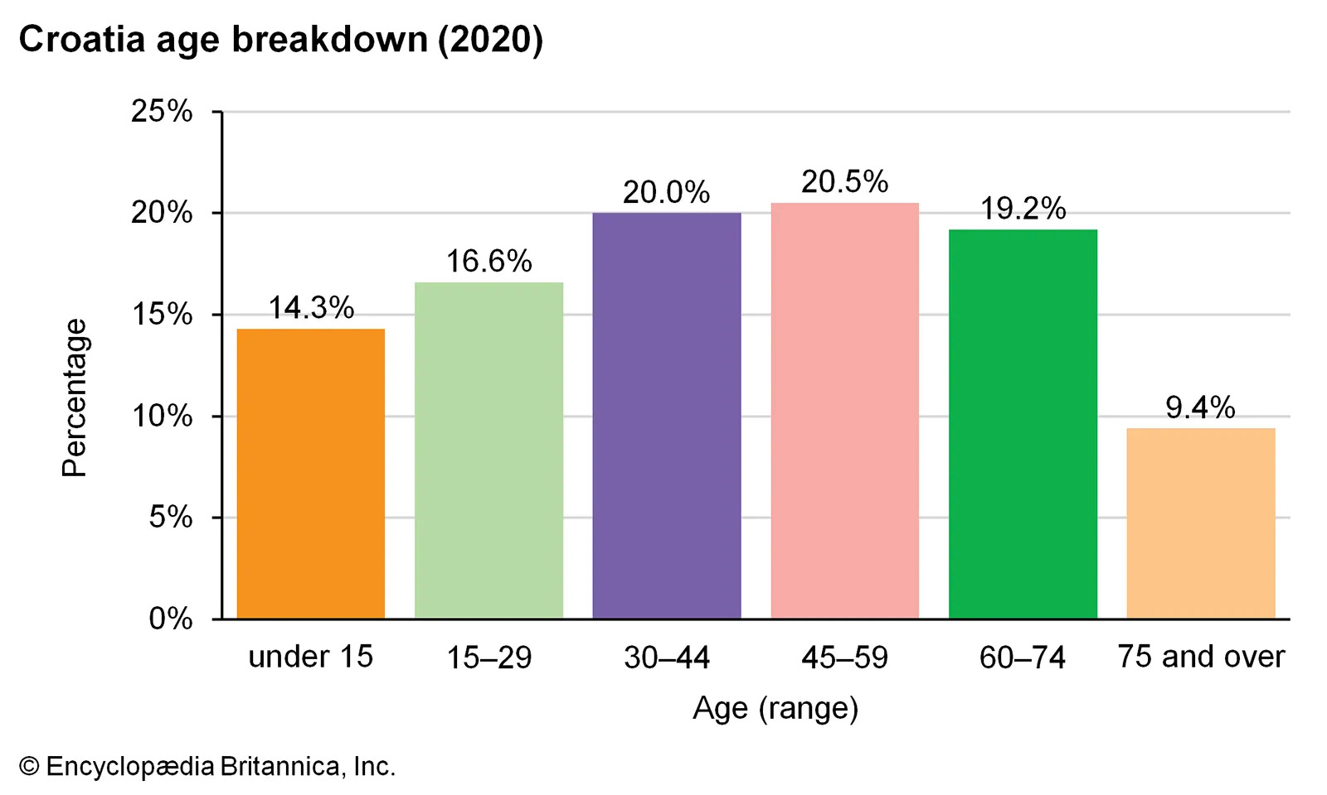
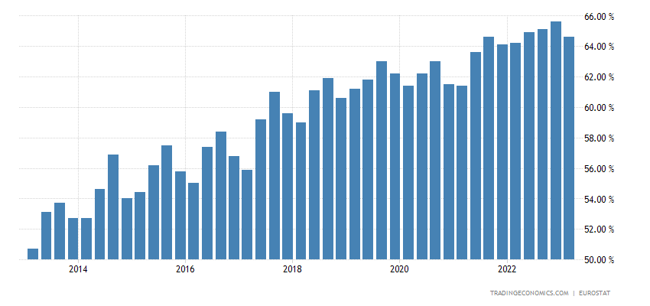
EMPLOYMENT
Age Breakdown of
Active Employment Holds
Hospitality in Good stead
Employment Rate Shows Resilience Through the Pandemic and Recession
CROATIA
BRAC
PROPERTY
General Info
Map
Key USP
Economy
Local Attraction
Beyond Tourism
Demography
Market Overview

Slide 15
Reason for tourist attraction
Travelling to Croatia can be pretty easy as it is very well connected to the rest of the world. Major tourist places such as Hvar, Split, Dubrovnik and Brac Islands very closely connected to each other and tourists can travel easily.
Croatia is known for its scenic pebbled beaches, that are lapped beautifully by the crystal-clear blue water. Brac’s Zlatini Rat is one such place which is also known as the Golden Cape. The tip of the beach changes with the direction of wind. There are many hidden beaches one explore in places such as Hvar.
The scenic beauty of the beaches and islands which the country has to offer is unparalleled. Fans of the show Game of Thrones can easily identify beaches and spots where famous scenes of the show were shot. The Fortress of Kliss, Dubrovonik’s city, Trsteno Arboretum are few of the famous tourist attractions due to the show.
In recent times, the country has been one of the most favorite tourists places for music festival lovers. Visiting Zagreb in the months of June or July is a must for music, food and fashion or film lovers, Dubrovnik’s Old Town Transforms into the Dubrovnik Summer Festival in July and August. The country is known for its love for music, films, art, heritage spots.
CROATIA
BRAC
PROPERTY
General Info
Map
Key USP
Economy
Local Attraction
Beyond Tourism
Demography
Market Overview

Slide 16
Reason for tourist attraction
The country offers a wide range of tourist spots from awe-inspiring ancient attractions such as Pula, a first century Roman amphitheater to rival the Rome’s Colosseum. Split with its 4th Century Diocletian’s Palace, ancient Porec on the Istrian Peninsula, Zadar’s Roman Forum.
From sailing to mountain biking, the country has a lot to offer for tourists of all kind. In Brac islands, one can hike Vidova Gora, go on mountain biking to explore the natural beauty of the country in the towns of Bol and Supetar.
The country has a wide range of fine food and even finer wine to its guest. Being on the seashore, the seafood is a must try when visiting the country along with their pasta. The country also creates edible cheese, Paski sir, one of the most famous cheese produced in Pag Island. Tourists can also expand their taste buds in experiencing different types of wine which is produced in the region.
CROATIA
BRAC
PROPERTY
General Info
Map
Key USP
Economy
Local Attraction
Beyond Tourism
Demography
Market Overview

Slide 17
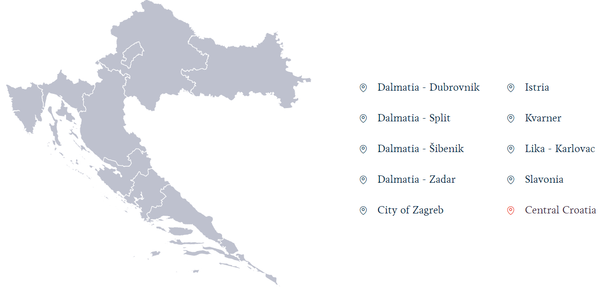
Croatia – a perfect 10
Ten tourism regions, ten chapters of Croatia's history, are assessed not by their size but rather by the beauty and variety of their natural surroundings, cultural legacy, and cuisine. Each of Croatia's ten tourism districts is teeming with intriguing locations, towns, breathtaking scenery, wonderful fragrances, sounds, and experiences that beckon exploration.
CROATIA
BRAC
PROPERTY
General Info
Map
Key USP
Economy
Local Attraction
Beyond Tourism
Demography
Market Overview

Slide 18
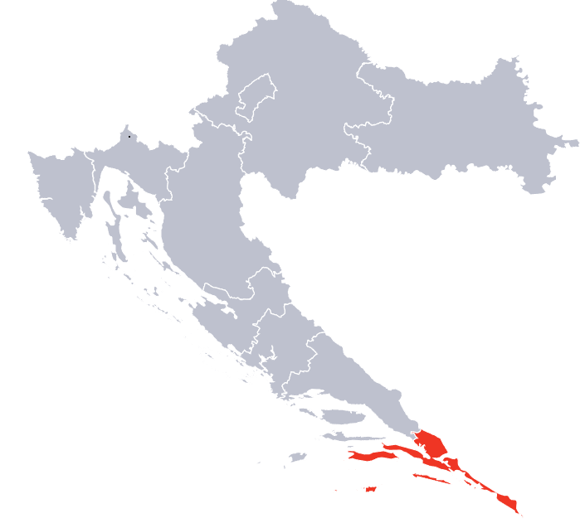
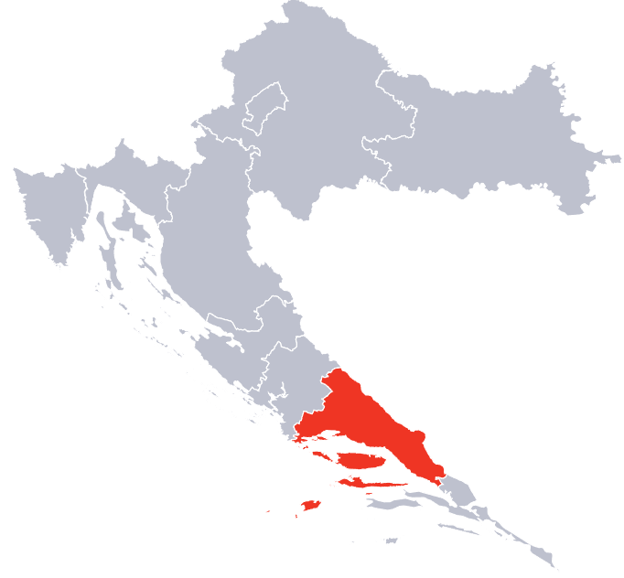
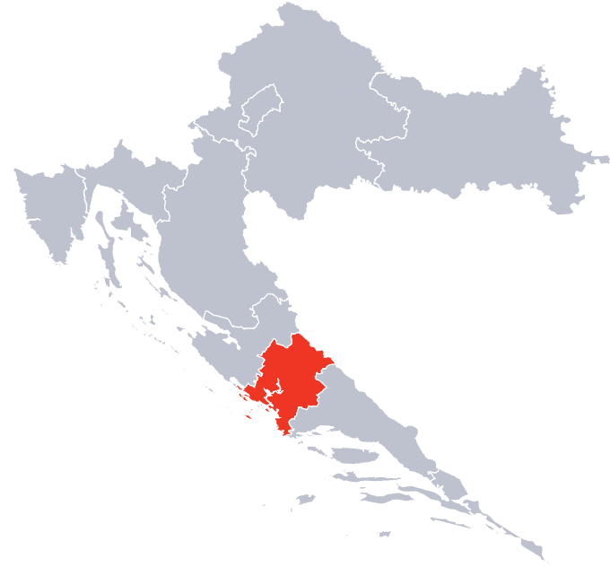
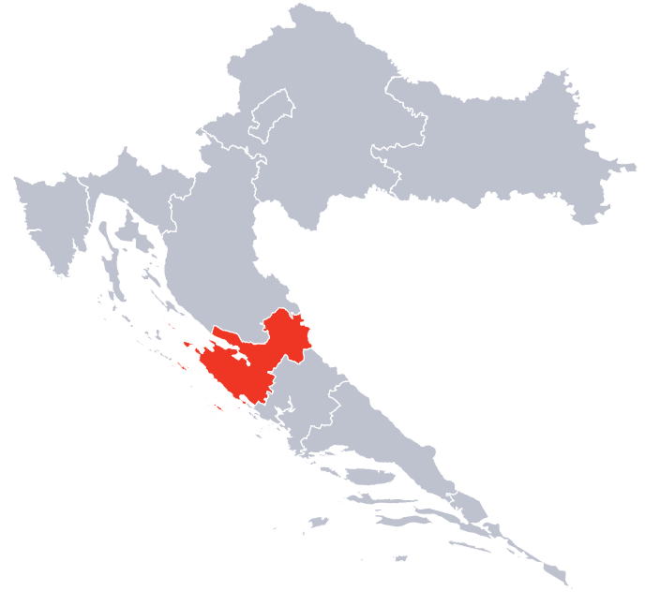
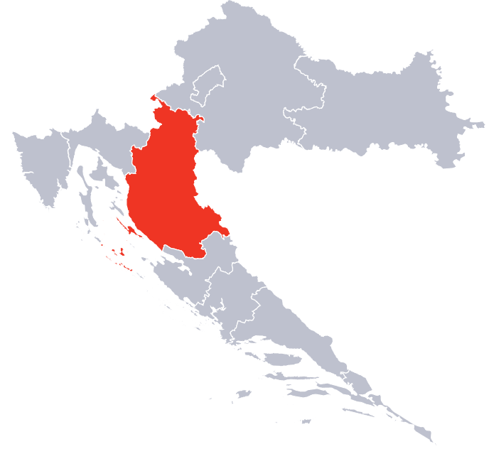
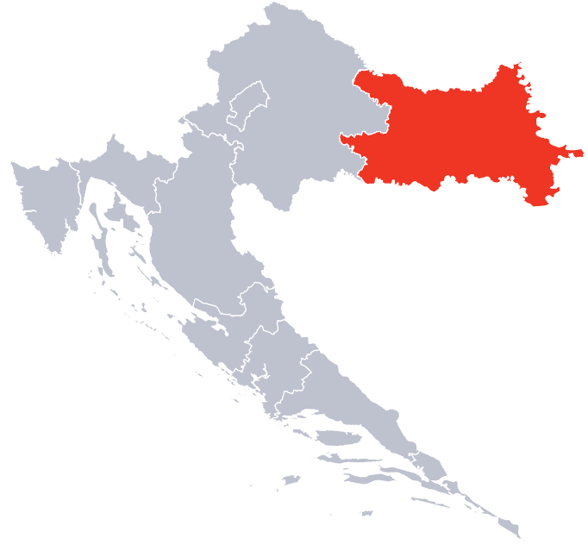
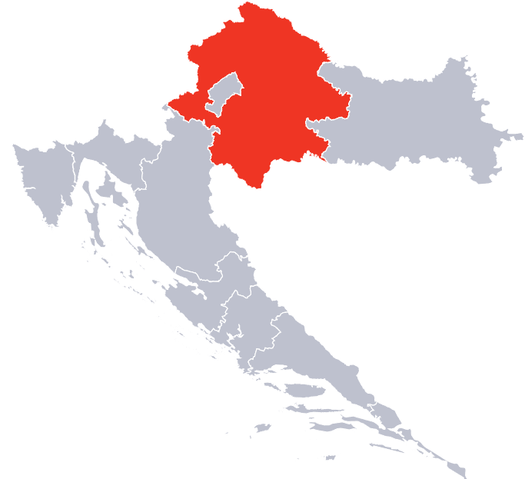
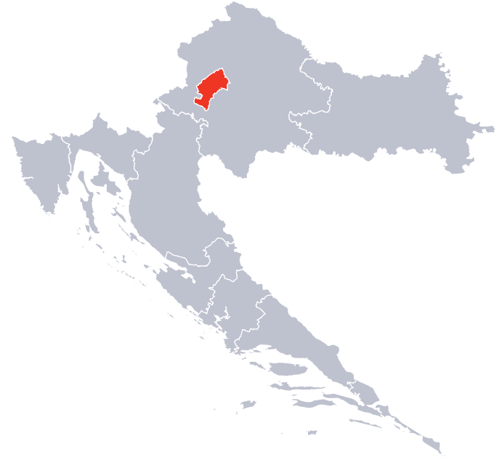
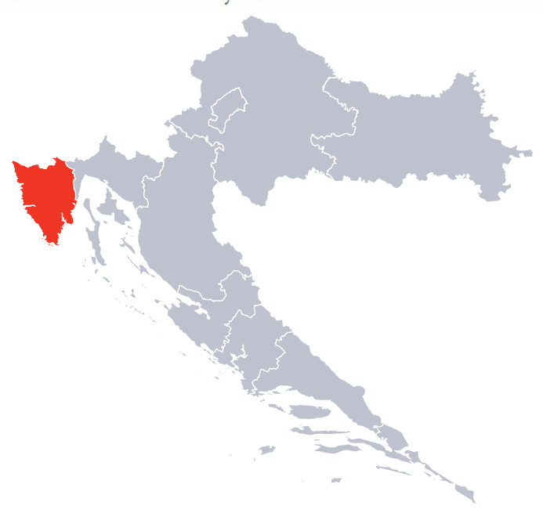
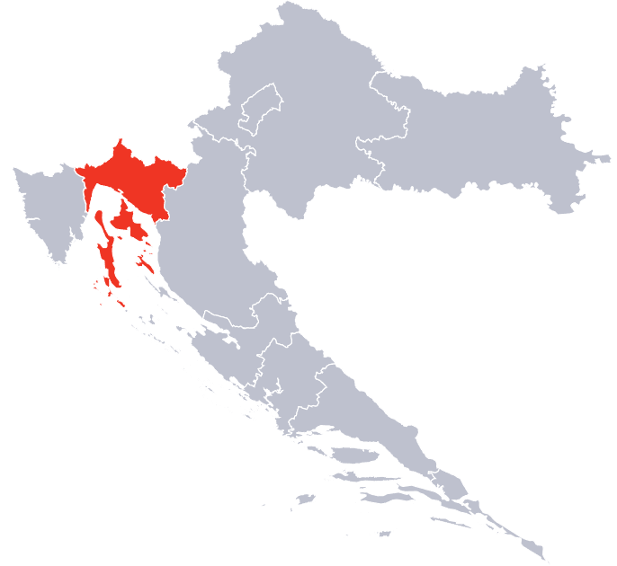
Croatia – a perfect 10
Dalmatia - Dubrovnik
Dalmatia - Split
Dalmatia - Šibenik
Dalmatia - Zadar
Lika - Karlovac
Slavonia
Central Croatia
City of Zagreb
Istria
Kvarner
CROATIA
BRAC
PROPERTY
General Info
Map
Key USP
Economy
Local Attraction
Beyond Tourism
Demography
Market Overview

Slide 19
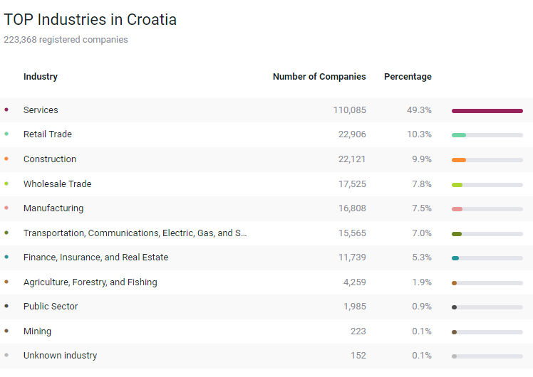
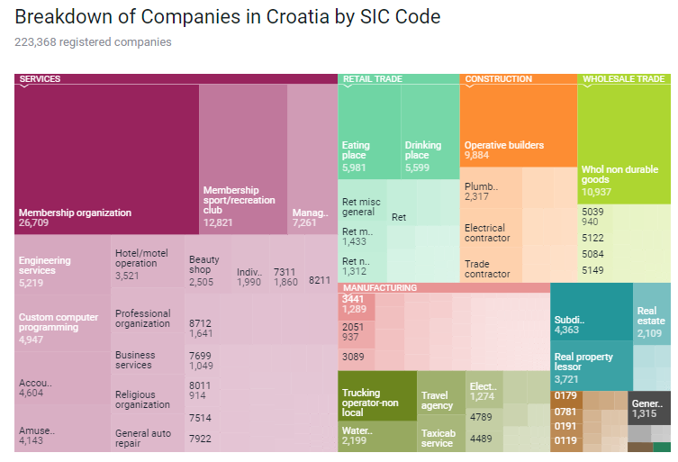

Business beyond tourism
Croatia offers home to various large corporations under the private ownership structure which is very vital in foreign trade. Based on reports, there are a total of 223,368 which forms about 0.49% of the 45,886,110 companies based out of Europe. The Services industry is the most popular industry in the country, with more than 49.5% of the total companies, followed by the Retail Trade (10.3%), Construction (9.9%), wholesale trade (7.8%) etc.
CROATIA
BRAC
PROPERTY
General Info
Map
Key USP
Economy
Local Attraction
Beyond Tourism
Demography
Market Overview

Slide 20
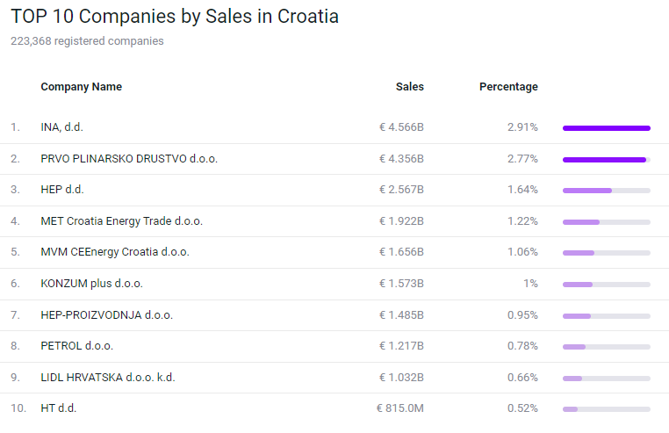
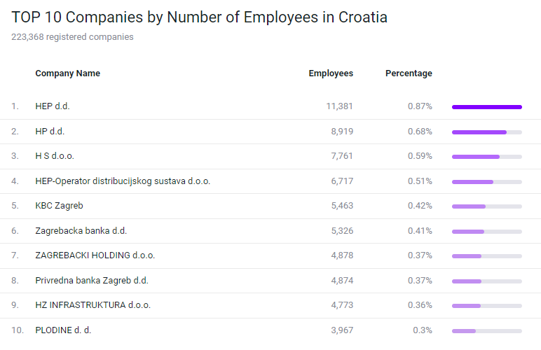
Top 10 companies
CROATIA
BRAC
PROPERTY
General Info
Map
Key USP
Economy
Local Attraction
Beyond Tourism
Demography
Market Overview

Slide 21
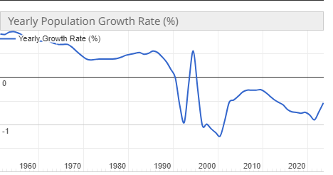
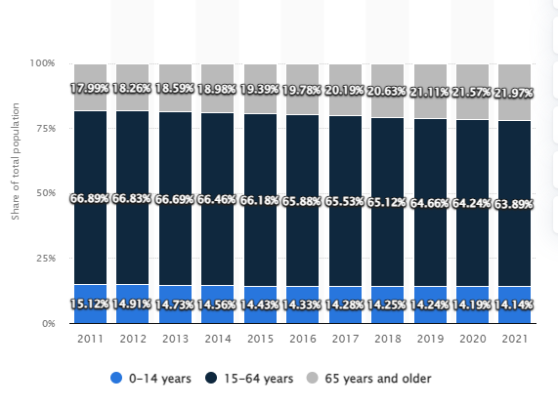
Demographics
Yearly Population Growth
Age groups in Croatia.
CROATIA
BRAC
PROPERTY
General Info
Map
Key USP
Economy
Local Attraction
Beyond Tourism
Demography
Market Overview

Slide 22
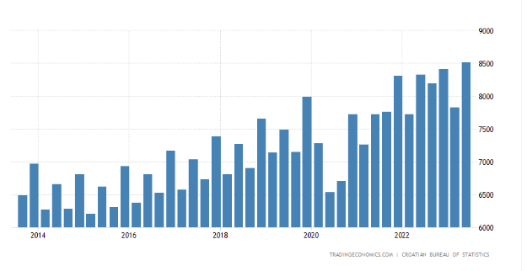
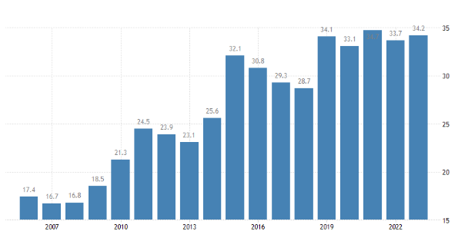
Demographics
Consumer Spending
Tertiary educational attainment, age group 30-34
CROATIA
BRAC
PROPERTY
General Info
Map
Key USP
Economy
Local Attraction
Beyond Tourism
Demography
Market Overview

Slide 23
BRAC ISLAND
Brač is an island located in the Adriatic Sea, part of Croatia. It is the third-largest island in the Adriatic, covering an area of around 396 square kilometers.
Major Town | The largest town on Brač is Supetar, located on the northern coast. It is a significant ferry port, connecting the island to the mainland.
Population | As of 2022, the total population of Brac was 13,824
Geography | The island is known for its diverse geography, including rugged coastline, pine forests, olive groves, and vineyards. It is also famous for its white limestone, which has been used in many historical and architectural landmarks.
Economy | The island has a strong tradition of agriculture, including the production of olives, grapes (used in wine-making), and other Mediterranean crops. In addition to water-based activities, Brač offers opportunities for hiking, cycling, and exploring its scenic landscapes
Culture & Tourism | Brač, like the rest of Croatia, has a rich cultural heritage. Various festivals, events, and cultural activities take place on the island throughout the year, offering visitors a taste of local traditions.
Notable Landmark | Besides its natural beauty, Brač also boasts several interesting landmarks, including the Dominican Monastery in Bol, the Bol Marina, and the Museum of the Island of Brač in Škrip.
CROATIA
BRAC
PROPERTY
General Info
Map
Key USP
Economy
Local Attraction
Beyond Tourism
Demography
Market Overview

Slide 24
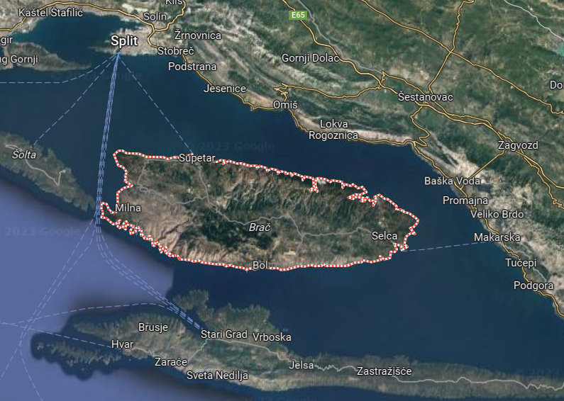
BRAC
CROATIA
BRAC
PROPERTY
General Info
Map
Key USP
Economy
Local Attraction
Beyond Tourism
Demography
Market Overview

Slide 25
Convenience / Attractions
Following are some of the local attractions, restaurants, and ports at Brac and near the property as well
PLACES TO VISIT | Travel Time | Distance
Vidova Gora | Drive : 44 mins | 27.3 km
Museum Uja | Drive: 37 mins | 22.5 km
Zlatni Rat Beach (Golden Horn) | Drive: 1 hour 2 min | 45.9 km
Blaca | Drive: 45 min | 16.1 km
Supetar Bay | Drive: 39 mins | 24.4 km
Golden horn beach | Drive: 1 hour 2 min | 45.9 km
Supetar cemetery | Drive: 28 min | 18.9 km
Dominican Monastery | Drive: 1 hr 1 min | 18.9 km
TRANSPORT / PORTS | Travel Time | Distance
Supetar Ferry Port | Drive : 30 mins | 20.3 kms
Airport Brac | Drive : 52 mins | 39.1 km
Bol Port | Drive: 1 hr 2 mins | 45.2 km
Bol Bus Terminal | Drive: 1 hr 2 mins | 45.2 km
Arriva Bus Tickets Supetar | Drive: 29 mins | 20.3 kms
Taxi Brac | Drive: 27 mins | 18.4 km
RESTAURANTS & WINE | Travel Time | Distance
Wine tasting Brac | Drive: 28 mins | 17.3 km
Stina Winery | Drive: 1 hr | 45.2 km
Wine tasting Hrapocusa Brac | Drive: 1 hr | 29.5 km
Konoba Kala | Drive: 29 min | 19.4 km
Zalogajnica "Restaurant Bago" | Drive: 13 min | 3.8 km
Konoba Kopačina | Drive: 26 min | 16.3 km
Restaurant - Konoba Štorija | Drive: 24 min | 17.7 km
CROATIA
BRAC
PROPERTY
General Info
Map
Key USP
Economy
Local Attraction
Beyond Tourism
Demography
Market Overview

Slide 26
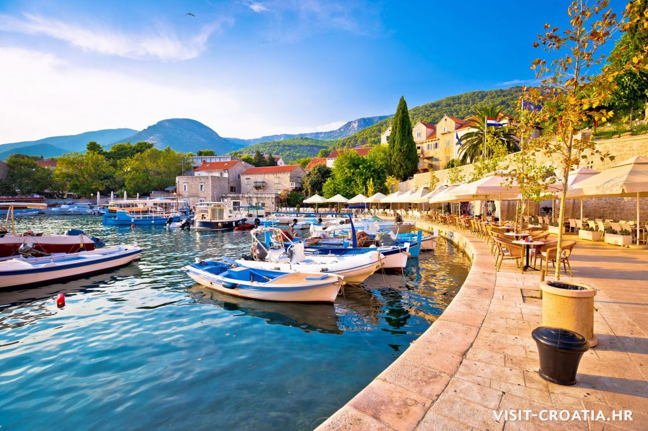
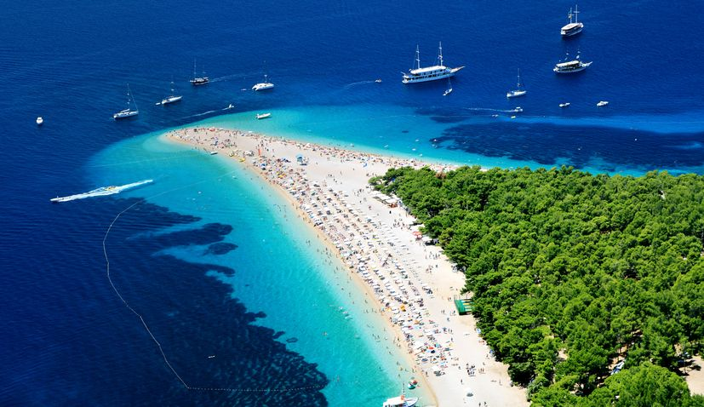
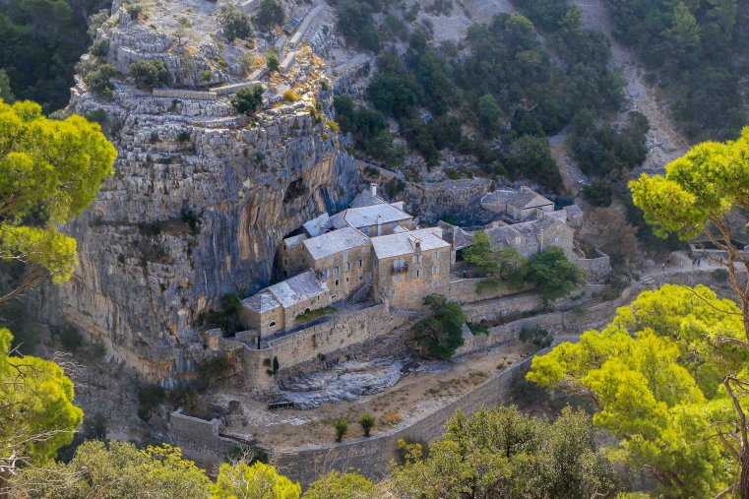
Hotspots for tourists in BRAC
BOL – It is one of the most famous spots in the Island of Brac where it attracts countless tourists every year. The place is located at the foothills of Vidova Gora and next to the famous Golden Horn. It is known for its beautiful beaches and its charming old town. Tourists can also enjoy local food and wineries with breath-taking views.
Zlatni Rat Beach (Golden Horn) – Located in the south of the island, close to Bol and is a must visit for all tourists. A unique crescent shape looking like a Golden Horn stretches almost 500 meters into the sea. The shape of this pebbled beach changes based on currents and tides.
Blaca Hermitage (Cave Monastery) – Located on a huge cliff in the interior of the island, the monastery was founded in 16th Century by Glagolitic monks. The museum can be reached by a short hike.
CROATIA
BRAC
PROPERTY
General Info
Map
Key USP
Economy
Local Attraction
Beyond Tourism
Demography
Market Overview

Slide 27
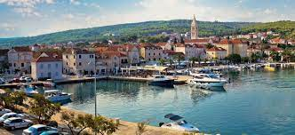
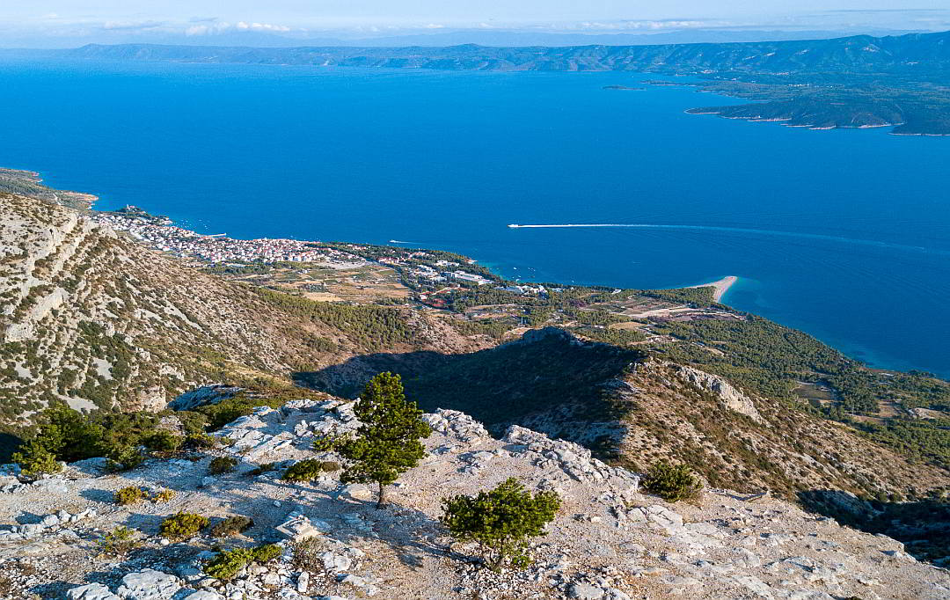
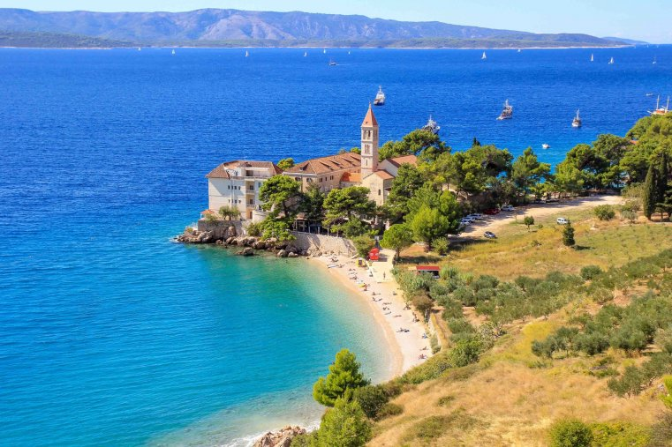
Hotspots for tourists in BRAC
Supetar – It is one of the largest town in the island with 3,500 population. It is located on the north coast and can be easily visited by a ferry from Split. With cozy restaurants and konobas line and the various parish churches are a must visit.
Mountain Vidora Gora – With a height of 778 meters from the sea level, it is one of the highest mountain in Croatia. The Golden Horn, and Hvar can be seen from the top. One can either take their car or hike from Bol for 2.5 hours.
Dominican Monastery – Established in 1475, it is one of the most beautiful attractions on the southern coast of Brac. It is located on a small peninsula of Glavica and surrounded by the Bijela Kuca and Martinica Beach.
CROATIA
BRAC
PROPERTY
General Info
Map
Key USP
Economy
Local Attraction
Beyond Tourism
Demography
Market Overview

Slide 28

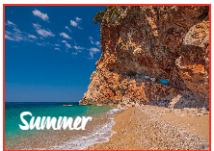

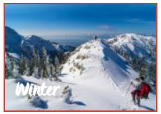
BRAC – An All season destination
The best times to visit Brac are in the late spring and early fall. The weather is frequently warm and dry from mid-May to mid-June, making it ideal for touring the island. Bright blue skies, aromatic, emerald-green forests, and lovely towns emerging from their winter hibernation.
The sunniest season provides an abundance of daylight for activities like going on excursions, attending summer festivals, concerts, and open-air events, and visiting some of the innumerable beaches that are splashed by the waves of one's fantasies.
As the people thin down along with the temps, nature begins creating a mystical mosaic of shifting hues. The best part is that the towns and cities are ripe with the fruits of fall, and a magical day spent in nature and watching the sun set is a wonderful ode to life.
Wintertime lows are rarely below zero degrees, although Vidova Gora, the island of Brac's highest point, occasionally experiences snowfall. Experiences to remember are ensured by sparkling lights, seasonal delights, and charming squares infused with the aromas of time-honored customs.
CROATIA
BRAC
PROPERTY
General Info
Map
Key USP
Economy
Local Attraction
Beyond Tourism
Demography
Market Overview

Slide 29

Market/submarket Overview

Slide 30
Market Overview
Unlocking the Growth Potential
Imagine pristine beaches caressed by the crystal-clear Adriatic Sea, charming historic cities, and a rich cultural tapestry – this is the enchanting backdrop of Croatia's burgeoning hospitality industry. The sector, characterized by a resilient upward trajectory in recent years, has positioned Croatia as a premier European destination. Let's delve into this thriving market, combining insights from recent data and expert analysis.
A Thriving Industry
The Croatian hospitality industry has emerged as a major player in the nation's economy, boasting a valuation of USD 15.2 billion in 2022 and displaying a robust Compound Annual Growth Rate (CAGR) of over 4%. Despite facing the brunt of the COVID-19 pandemic, with travel restrictions and lockdowns affecting performance, the industry showed remarkable resilience. The peak tourist season, typically spanning from May to September, saw a dip due to cancellations and postponements, but the sector remains buoyant.
The Demand Surge
Croatia's appeal as a tourist hotspot has drawn visitors from Germany, Slovenia, Austria, Italy, and the UK. The nation's diverse offerings cater to sun-seekers, history buffs, nature enthusiasts, and yacht aficionados. Coastal regions thrive during the summer, while cities like Zagreb and Zadar provide year-round attractions. Croatian cuisine has gained international acclaim, with tourists seeking authentic culinary experiences, wine tours, and farm-to-table dining.
A Diverse Landscape The hospitality industry encompasses a broad spectrum of businesses, including hotels, restaurants, bars, resorts, event venues, and more, all dedicated to ensuring exceptional guest experiences. Croatia's hospitality market is segmented into chain and independent hotels, as well as service apartments, budget, economy, mid to upper-mid-scale, and luxury hotels.

Slide 31
Market Overview
Investment Magnet The growth story of Croatia's hospitality industry is anchored in high demand and limited supply. Investors from around the world are drawn by the country's low crime rate, safe environment, and strong tourism potential.
Foreign Investment
Approximately a quarter of real estate buyers in Croatia are foreigners, primarily Germans, Slovenes, and Austrians. With excellent transport connections to European Union countries and a burgeoning air travel network, Croatia is becoming a hotspot for foreign property buyers.
Return on Investment
Real estate in Croatia is not only a haven for tourists but also for investors. High-quality properties, especially those with sea views, offer returns on investment ranging from 6% to 8%, making it an attractive proposition.
Future Prospects
While forecasting price movements is challenging, indications point to continued growth in Croatia's real estate market. Factors such as subsidized loan programs, interest rates, and inflation may influence the market, but the prevailing narrative suggests that the demand for Croatian real estate will remain robust.
Sustainability
Croatia, cognizant of the importance of preserving its natural beauty, has taken steps towards sustainable tourism practices. This not only enhances its global appeal but also contributes to the long-term viability of the industry. Sustainable initiatives include eco-friendly accommodations, responsible tour operators, and efforts to protect fragile ecosystems, making Croatia an attractive destination for eco-conscious travelers.
With its unique blend of natural beauty, rich culture, and investment opportunities, it continues to attract travelers and investors alike. The market is poised for an exciting future, offering both economic prosperity and unforgettable experiences to all who enter its borders.

Slide 32
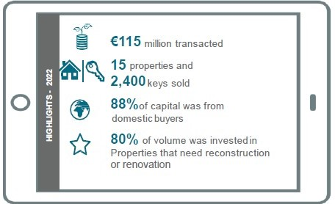
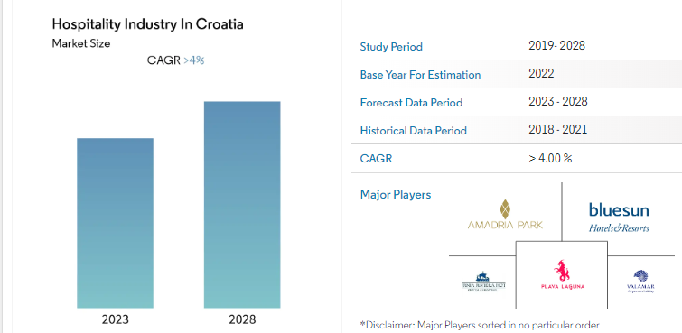
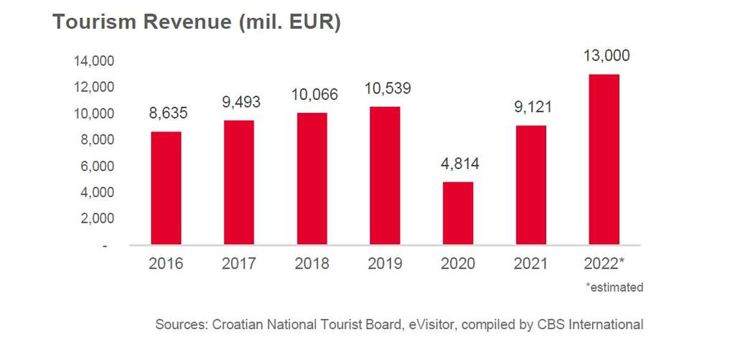
Market (Travel & tourism) Overview
A Growing Hotel Investment Market

Slide 33
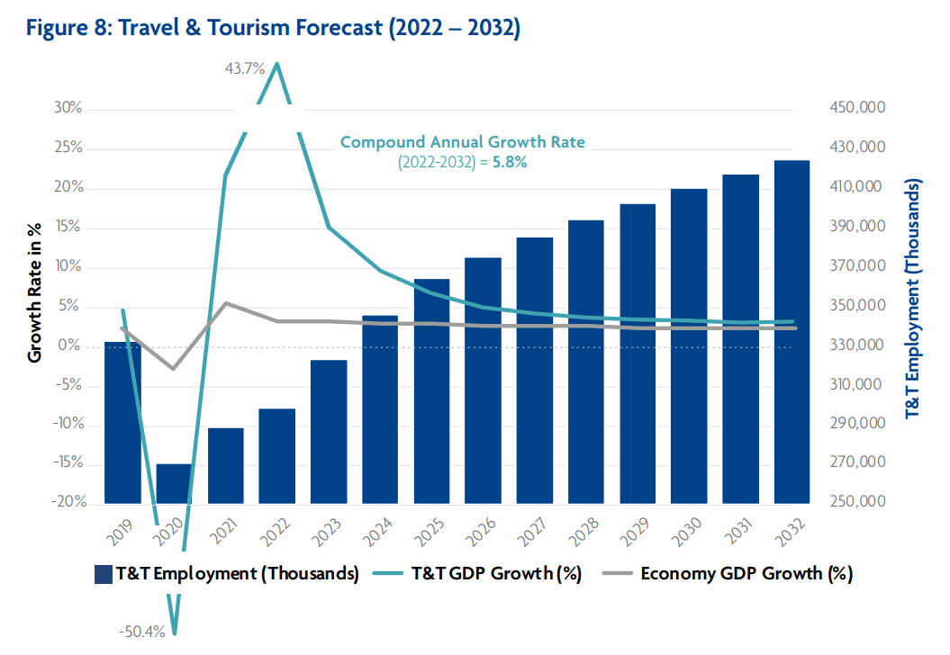
Market (Travel & tourism) Overview
Travel & Tourism Forecast for Croatia (2022-2032)

Slide 34
Submarket (Hotel & Hospitality) Overview
Brac, Croatia: A Rising Star in the Hospitality Sector The island of Brac, nestled in the Adriatic Sea, has emerged as a rising star in Croatia's hospitality sector. Known for its pristine beaches, historic towns, and vibrant local culture, Brac has become an attractive destination for tourists seeking a serene getaway. The island's tourism industry has witnessed steady growth in recent years, with an increasing number of visitors from both domestic and international markets. One of Brac's unique selling points is its stunning coastline, which boasts a plethora of secluded coves and crystal-clear waters. These natural wonders have made the island a hotspot for water sports enthusiasts, yachting enthusiasts, and beach lovers. The charming towns of Bol, Supetar, and Postira offer a glimpse into Croatia's rich heritage, with their cobblestone streets, quaint architecture, and traditional cuisine. In the hospitality sector, Brac has seen significant investment in recent years, resulting in the development of modern resorts, boutique hotels, and luxury villas. This expansion caters to the diverse needs of tourists, from those seeking a luxurious retreat to budget-conscious travelers looking for cozy guesthouses. Additionally, the island's commitment to sustainable tourism aligns with the global trend towards responsible travel. Brac's strategic location, just a short ferry ride from Split, has contributed to its accessibility, making it an ideal destination for both short getaways and extended vacations. As the hospitality industry on the island continues to flourish, Brac is poised to capture the hearts of travelers seeking an authentic Croatian experience in a picturesque setting.

Slide 35
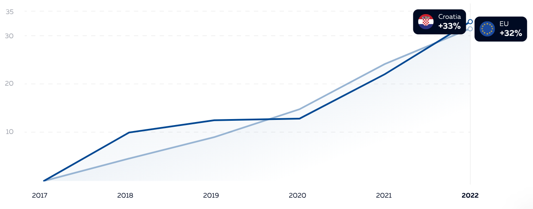
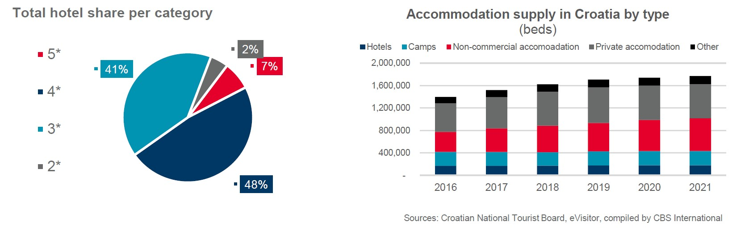
Submarket (Hotel & Hospitality) Overview
The Rising Residential Index Of Croatia Compared the Rest of the Europe

Slide 36
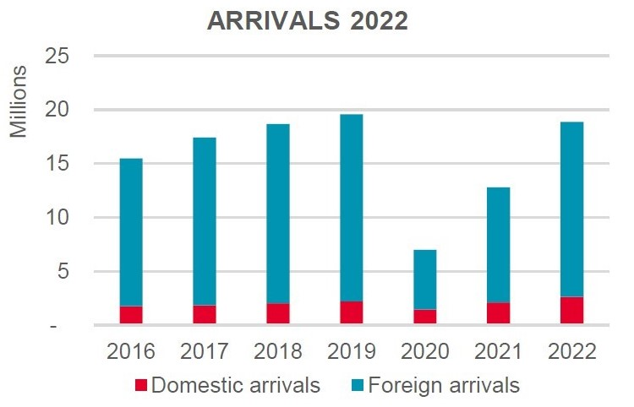
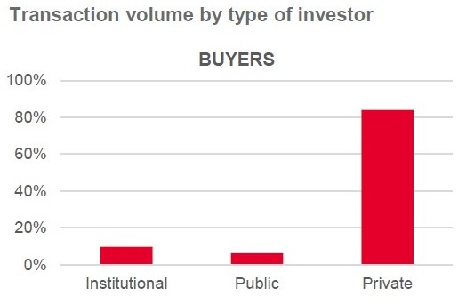
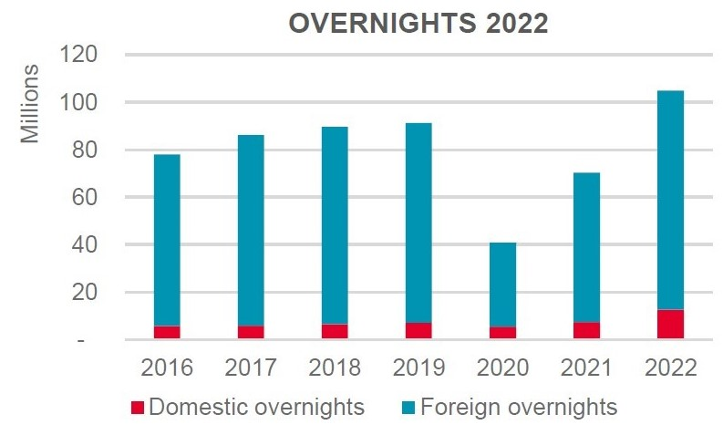

Submarket (Hotel & Hospitality) Overview
Foreign Visits and Stays
Transaction Volume by Investment Type

Slide 37

Property Map

Slide 38
Site Description
Configuration: | Irregular
Topography: | Generally level
Drainage: | Assumed adequate
Floodplain: | According to National Flood Insurance Rate Map Community Panel No. 48201C0830L (June 18, 2007), the subject property lies within FEMA Zone X; areas determined to be outside the 500‐year flood plain.
Frontage: | South side of Briar Forest Drive and the east side of Lakeside Estates Drive
Access: | Curb cuts on the south side of Briar Forest Drive and the east side of Lakeside Estates Drive
Utilities: | Adequate utilities are available and in place at the site for typical multifamily uses, including water, sewer, electricity, and telephone.
Site Improvements: | The site improvements include parking areas, landscaping, and drainage. Building improvements are detailed in the next section.

Slide 39


Site Description
PLAT MAP
FLOOD MAP

Slide 40
Site description
Accomodation: The property has a total of 189 rooms out of which 30 are located in the main building, 109 Bungalows and 50 Cottages. The Main building has 18 standard double rooms, 7 Superior rooms, 3 One bedroom suite, 2 two bedroom suites. For the bungalows, it has 7 standard double rooms, 42 Junior suite, 30 Loft Junior Suite, 30 one bedroom suites. There are 40 forest cottages and 10 vineyard cottages.
Property Amenities: the stylish rooms offer free Wi-Fi, flat-screen TVs and sofabeds. Upgraded quarters add sitting areas, while a 1-bedroom suite offers a wet bar and a kitchenette.
There's a bar and a restaurant with a terrace. Other amenities include an indoor pool, an outdoor pool and a kids' pool, as well as a kids' club and playground. There's also a gym and a spa, in addition to sporting activities, and a private beach with sunloungers. Breakfast and parking are available along with a vineyard.
Condition: Since acquisition the current owner has implemented significant capital expenditures. A majority of the subject units have been upgraded to include the following: granite or resurfaced Formica countertops, stainless steel or black appliances, fixtures, hardware, blinds, lighting and other minor renovations.
Walls: Painted drywall over wood studs
Floor Covering: Kitchen: Faux‐wood vinyl or Sheet vinyl
Living: Faux‐wood vinyl or Carpet
Bath: Faux‐wood vinyl or Sheet vinyl
Countertops: Kitchen: Formica (77%) Granite (23%)
Bath: Formica (77%) Granite (23%)

Slide 41

UNIT MIX

Slide 42




FLOOR PLAN

Slide 43

Rent Comps

Slide 44
Sales Comps
Hotel Name | Rooms | Location | Area (m2) | Price (EUR)
Hotel Crikvenica | 100 | Crikvenica | 5500 | 8,000,000
Hotel Bol | 50 | Bol | 1150 | 9,300,000
Hotel Pula | 20 | Pula | 300 | 3,200,000
Hotel Zagreb | 75 | Zagreb | 1211.5 | 2,380,000
Hotel Split | 40 | Split | 800 | 2,500,000
Hotel Umag | 200 | Umag | 19500 | 14,500,000
Hotel Rijeka | 50 | Rijeka | 1205 | 2,000,000

Slide 45

Sales Comps

Slide 46

Sales Comps

Slide 47

XXMilan resort Area Info

Slide 48




AWARDS, Accolades AND REVIEWS
The resort has been awarded ‘Travelife Gold Award’ by London based organization Travelife for outstanding sustainability measures at the resort. The organization and award is supported by major European Tour Operation Associations like FTO, ANVR, ABTO and FAR.
The resort has also featured in the Travelers’ Choice 2023 award by Tripadvisor. Accommodations, attractions, and restaurants that consistently receive excellent evaluations from visitors and are placed in the top 10% of properties on Tripadvisor are given a Travellers' Choice award.
Consistent high rating across different platforms for providing outstanding services.

Slide 49



Sustainability - Walking the extra mile
The resort has taken multiple measures to ensure sustainability and low impact on the environment. Some of the measures include the following
Water Management – the management takes extra care towards the preservation of water and reduction of the cost of water. Installation of prelators, awareness, and education for staff as well as guests, and monitoring pool water thrice a day to reduce change are some of the measures taken.
Waste Management – The resort works on the principle of Prevention – Reduction – Reuse – Recycle – Recover – Dispose. The green waste is used for compost creation while bio waste is given to the local population for feeding animals. The oil and grease from the kitchen is handed over to an authorized collector. As per 2021 statistics, the resort was able to reduce its waste generation by 70% as compared to the previous few years.
Reduction of Chemical Usage – The resort has partnered with ECOLAB to ensure the minimization of chemical usage. As per 2021 statistics, the resort was able to reduce its chemical usage by 20% as compared to the previous few years.

Slide 50



Sustainability - Walking the extra mile
The resort has taken multiple measures to ensure sustainability and low impact on the environment. Some of the measures include the following
Food Management – the resort promotes organic farming and has its own gardens which grow more than 10 kinds of vegetables. There is a separate olive cultivation which boasts a field of more than 1800 olives. Organic farming is completely eco-produced using only water and homemade compost.
Energy Management – Reduction of energy usage not only helps in improving profitability but it is good for the environment too. To ensure the same, the resort has installed LED lighting all across the resort powered by an automatic lighting system to reduce power usage. It has also installed primary and secondary heating systems to support the cause.
Supplies and Procurements – The resort promotes local businesses and smaller players for an all-round development. More than 20% of the suppliers are from Brac Island itself. Further, it sells local products at its reception and invites local artists to entertain the guests.

Slide 51

Property Pictures

